Slide 1


Slide 2

Advanced Networks
People's Democratic Republic of Algeria
Ministry of Higher Education and Scientific Research
Specialty: Computer Security
Prepared by: Dr, Elhachi Hana
Semester: 7 Credit: 5 Coefficient: 4

Slide 3
Chapters:
Introduction to Advanced Computer Networks
Network Security
Quality of Service (QoS)
Emerging Network Technologies
Advanced Routing and Switching
Network Management and Monitoring
Wireless and Mobile Networks
Future Trends and Challenges

Slide 4
Objective: Understand advanced routing algorithms and protocols Configure and analyze OSPF, EIGRP, and BGP Explain VLANs, STP, EtherChannel Apply redundancy and high-availability mechanisms Identify Layer 2 & 3 security attacks Understand modern SD-Access / SD-WAN routing concepts
Chapter 05
Advanced Routing and Switching

Slide 5
Dynamic Routing Protocols
Dynamic Routing Protocols
Distance Vector Protocols
Link Stat Protocols
Path Vector Protocols
BGP (Border Gateway Protocol)
RIP (Routing Information Protocol)
IGRP (Interior Gateway Routing Protocol)
OSPF (Open Shortest Path First)
IS-IS (Intermediate System to Intermediate System)

Slide 6
Distance Vector Routing Protocols
A Distance Vector (DV) routing protocol determines the best path to a destination based on:
Distance → A metric (hop count, delay, bandwidth, composite metric)
Vector → The direction or next-hop router to reach that destination
Key Concept
Routers using DV have NO full understanding of the network topology.
They rely entirely on what their neighbors tell them → “Routing by rumor.”
How routers behave:
Each router builds a routing table based on:
Self-connected networks
Information received from neighbors
The router trusts that its neighbors provide valid information.
Decisions are local, not based on global topology.

Slide 7
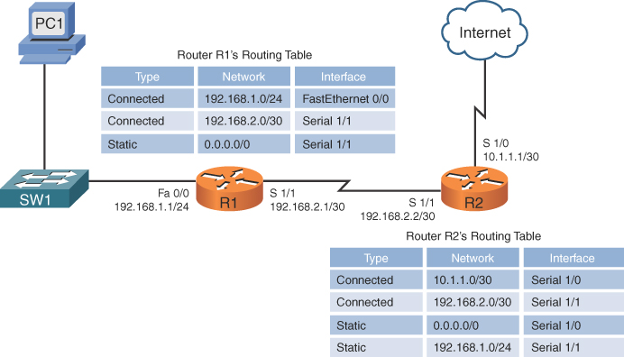
How Distance Vector Works
1. Periodic Updates
Routers send their entire routing table to neighbors at fixed intervals (e.g., RIP = every 30 seconds).
2. Routing Table Exchange
Each update includes:
Destination network
Metric to reach it
Next-hop address
3. Update Logic
When a router receives an update:
It increments the metric
Compares it to the existing route
Chooses the route with the shortest metric
Updates its table if the new route is better
4. Limited Visibility
Routers know:
Only the best next hop
Not the full path
Not the entire network map
This is why DV converges slowly and is prone to routing loops.

Slide 8
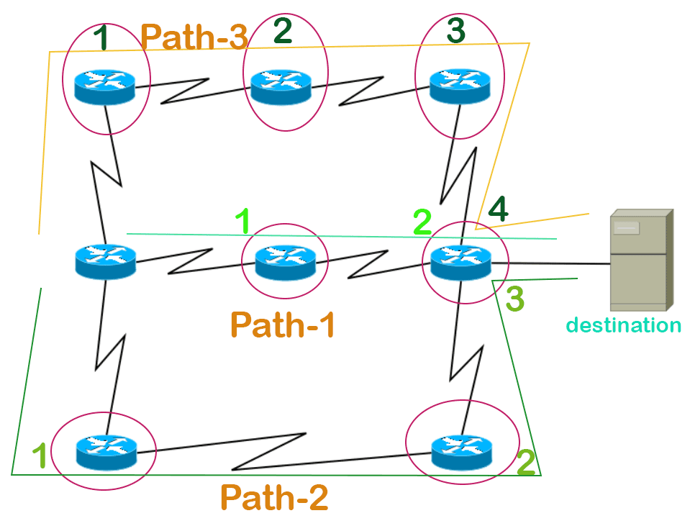
DV Characteristics
No Topology Awareness
Routers know only:
Destination → Metric → Next Hop They have no concept of links or full network map.
Simple Implementation
Very low CPU and memory requirements:
Suitable for small or low-power routers.
Periodic & Full Table Updates
Even if nothing changes, routers keep broadcasting all known routes.
Slow Convergence
A change (link failure, new route, metric update) requires several update cycles to propagate.
Loop Vulnerability
DV protocols naturally risk:
Counting to infinity
Temporary routing loops
Inconsistent routing tables during changes

Slide 9
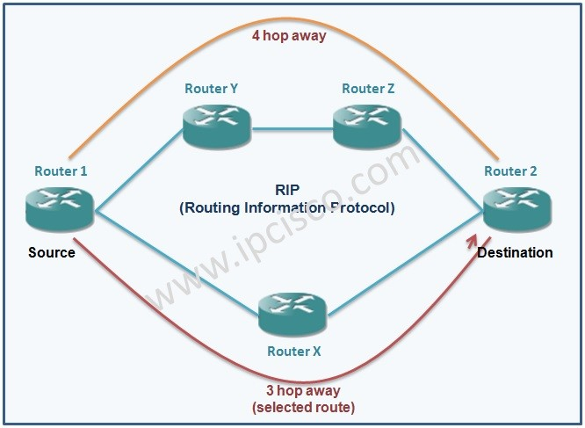
Routing Information Protocol (RIP)
RIP is one of the oldest distance vector protocols, originally defined in RFC 1058 (RIP v1) and later improved in RFC 2453 (RIP v2). It is widely used in small to medium-sized networks.
Key Characteristics: Metric: Hop count, Maximum hop count: 15 (16 = unreachable), Update interval: 30 seconds, Algorithm: Bellman–Ford, Protocol type: DV
Operation
RIP routers periodically broadcast their entire routing table to all neighbors. Each entry includes a destination network and hop count. Upon receiving neighbor routes, the router:
Adds 1 hop to each received metric.
Selects the route with the lowest hop count.
Updates its routing table.

Slide 10
Routing Information Protocol (RIP)
Advantages
Very simple to configure
Low computational and memory cost
Suitable for small networks
Limitations
Slow convergence
Susceptible to routing loops
Hop-count metric is too simplistic
Poor scalability
Does not consider bandwidth or load

Slide 11
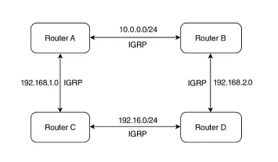
Interior Gateway Routing Protocol (IGRP)
Overview
IGRP was developed by Cisco as an improvement over RIP. Although based on distance vector principles, it uses a composite metric for better routing decisions.
Key Characteristics
Metric: Composite (bandwidth, delay), Maximum hop count: 255 (default 100)
Update interval: 90 seconds, Algorithm: Distance vector with advanced metric weighting
Composite Metric Formula: Bandwidth, Delay
This makes routing decisions much more reflective of real network conditions than RIP.
Advantages
Better scalability than RIP
Supports larger networks
More accurate routing via composite metrics
Limitations
Still suffers from loops and slow convergence
Proprietary (Cisco only)
Eventually replaced by EIGRP

Slide 12
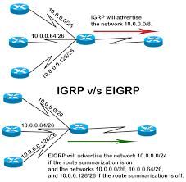
EIGRP (Enhanced Interior Gateway Routing Protocol)
Overview
EIGRP is often classified as an advanced distance vector or a hybrid routing protocol because it incorporates both distance-vector and link-state features. It uses the Diffusing Update Algorithm (DUAL) to guarantee loop-free and fast route convergence.
Key Characteristics: Metric:Composite (bandwidth, delay, reliability, load, MTU), Convergence: Very fast (thanks to DUAL), Update mechanism: Partial, triggered updates, Proprietary: Originally Cisco-only; now partially open standard
Advantages
Fast convergence
Loop-free routing (mathematically guaranteed)
Uses partial updates (more efficient)
Scalable and suitable for large enterprise networks
Supports unequal-cost load balancing
Limitations
More complex than RIP
Was proprietary for decades (now open but still primarily Cisco-based)
Metric Calculation
EIGRP metric is based on a weighted formula using:
Minimum bandwidth
Cumulative delay
Optionally: reliability and load

Slide 13
Comparison
Feature | RIP | IGRP | EIGRP
Metric | Hop count | Composite | Composite
Max Hop Count | 15 | 255 | None (uses metric)
Update Interval | 30s | 90s | Triggered
Convergence | Slow | Moderate | Fast
Algorithm | Bellman-Ford | DV | DUAL
Scalability | Low | Medium | High
Proprietary | No | Yes (Cisco) | Yes/Partial
Loop Avoidance | Basic | Basic | Built-in loop-free design

Slide 14
Link State Protocol?
Link State (LS) protocols build and maintain a synchronized map of the entire network.
Each router:
Discovers neighbors
Measures link costs
Generates Link State Advertisements (LSAs)
Floods LSAs to all routers in the area
Builds a Link State Database (LSDB)
Runs Dijkstra’s SPF algorithm to compute shortest paths
Link State Characteristics:
Event-Driven Updates
Routers send LSAs only when topology changes.
High Resource Consumption More CPU More RAM Larger control plane capacity
Fast Convergence Changes are detected quickly (Hello packets) Only incremental LSAs are exchanged SPF is executed locally
Hierarchical Design Allows splitting into areas (OSPF Area 0 (backbone) Reduces LSDB sizes Improves scalability)

Slide 15
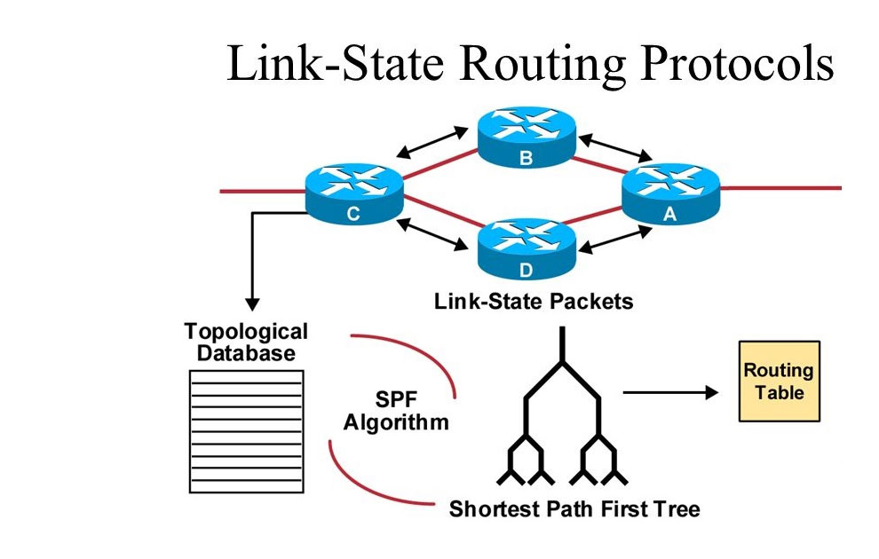
How Link State Works
Step-by-Step Operation
Neighbor Discovery
Routers exchange Hello packets
Build an adjacency list
LSA Generation
Each router creates LSAs describing local links:
Link interfaces
Connected networks
Link metrics
Router IDs
Flooding (Not Broadcasting)
LSAs are reliable flooded to all routers in the area
Ensures synchronized LSDBs
LSDB Construction
All routers hold the same database
A “map” of the network
SPF Calculation
Dijkstra’s algorithm computes shortest paths
Creates the routing table

Slide 16
DV vs LS
Feature | Distance Vector (DV) | Link State (LS)
Topology Knowledge | Neighbors only | Full network map
Update Type | Periodic, full table | Event-driven incremental LSAs
Convergence | Slow | Fast
Complexity | Low | High
Resource Use | Low CPU/memory | High CPU/memory
Loop Risk | High | Very low
Scalability | Small networks | Large enterprises & ISPs
Examples | RIP, EIGRP | OSPF, IS-IS
Algorithm | Bellman-Ford | Dijkstra (SPF)

Slide 17
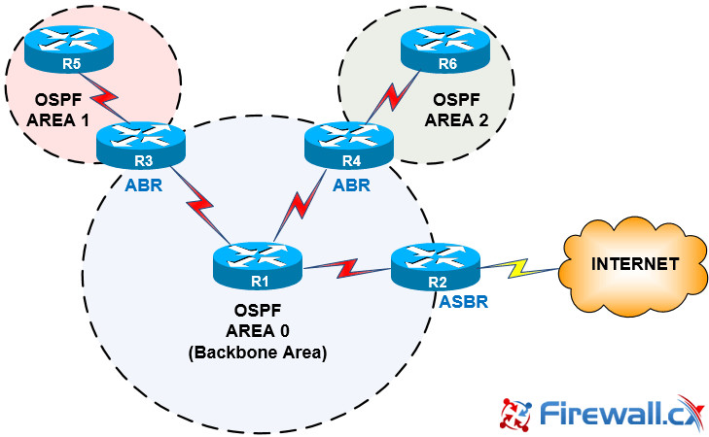
OSPF
Open Shortest Path First is a Link-State Interior Gateway Protocol (IGP) used inside an Autonomous System to exchange routing information.
Key properties
Link-State → routers maintain a synchronized map of the entire area
Standardized (v1 for IPv4, v2 for IPv6)
Fast convergence (thanks to SPF and incremental LSAs)
Hierarchical design using multiple areas
Widely used in enterprises and service provider networks
Area 0 is the core of the OSPF domain. All other areas must connect to Area 0.
An Area Border Router (ABR) is a router with
interfaces in Area 0 and at least one non-backbone
area.
An ASBR connects the OSPF domain to an
external routing domain,
OSPF has three main phases:
Becoming neighbors
Exchanging databases
Adding the best routes

Slide 18
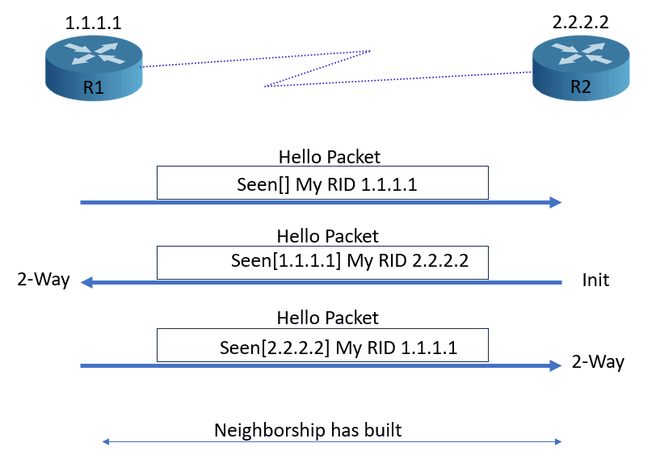
OSPF States
Becoming Neighbors (Neighbor Discovery)
In this phase, OSPF routers identify each other and decide whether they should form an adjacency.
Init state
Hello packets are exchanged on multicast address 224.0.0.5
Routers check OSPF parameters:
Area ID
Hello/Dead timers
Authentication type and key
Stub area flag
Network mask
2-Way state
If parameters match → routers become
neighbors

Slide 19
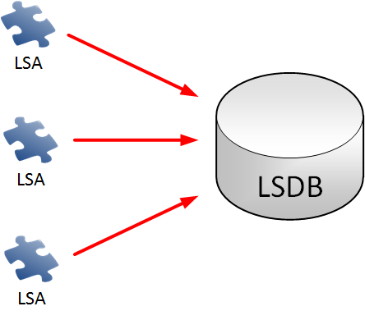
OSPF States
LSAs (Link State Advertisements) are the basic building blocks of OSPF topology information, and the LSDB (Link State Database) is a collection of these LSAs that all routers in an OSPF area use to maintain an identical map of the network.
Routers flood LSAs to share information about their links and neighbors, and the LSDB contains all this data to allow each router to independently run the shortest path first (SPF) algorithm and calculate the best routes.
LSA contains:
RID
Links
Addresses
Status info
Cost

Slide 20
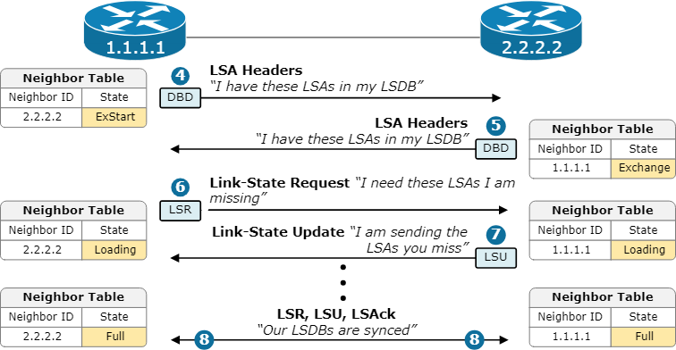
OSPF States
Exchanging Databases (LSA Exchange)
Once routers become neighbors, they must synchronize their Link-State Databases (LSDB).
ExStart/Exchange states:
Database Description Packets (DBDs)
Summary of LSA headers
Used to compare what each router has
Loading states:
Link-State Request Packets (LSRs)
Routers request missing LSAs found during DBD
comparison
Link-State Update Packets (LSUs)
Contain full LSAs sent in response to LSRs
Carry Types 1–5 (and 7 if using NSSA)
Link-State Acknowledgments (LSAscks)
Ensure reliable flooding of LSAs
Full state:
Complete exchanging databases

Slide 21
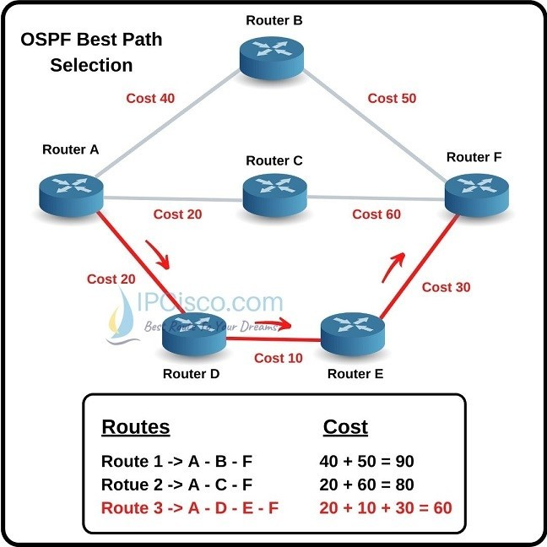
OSPF States
Adding the Best Routes (SPF Calculation)
After the LSDB is synchronized, each router independently runs:
Dijkstra’s SPF Algorithm
Computes the shortest path tree (SPT)
Determines metric (cost = reference bandwidth / interface bandwidth)
Selects the best path to every destination
The formula ”cost = reference bandwidth / interface bandwidth” is used by the OSPF routing protocol to calculate the cost of a network interface. The default reference bandwidth is 100 Mbps, and OSPF divides this value by the interface's bandwidth to determine its cost. This cost is used by the Shortest Path First (SPF) algorithm to determine the most efficient path for data to travel.

Slide 22
Border Gateway Protocol (BGP)
BGP is the main routing protocol of the Internet.
It decides how data travels between different organizations, called Autonomous Systems (AS).
Unlike OSPF or RIP (which find the shortest path), BGP focuses on policy and control:
Which ISP you want to use: Network operators can choose which Internet Service Providers to route traffic through based on criteria such as cost, reliability, and performance metrics.
Which paths you want to avoid: BGP allows administrators to designate certain routes as less desirable, enabling them to prevent traffic from traversing specific paths that might be slower, more congested, or less secure.
How you want traffic to enter or leave your network: With BGP, organizations possess the capability to dictate how data enters and exits their networks, allowing them to manage bandwidth usage effectively and optimize performance for end-users.
Why is BGP necessary?
The Internet is made of thousands of independent networks (ASes).
Each AS may have different goals, pricing agreements, and traffic rules.
BGP allows them to exchange routes in a flexible and controlled way, not just “fastest path.”

Slide 23
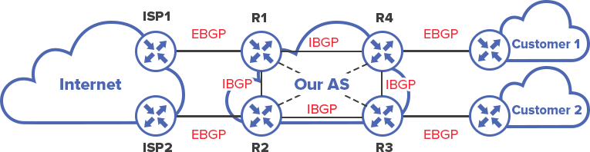
Types of BGP: eBGP vs iBGP
1. eBGP (External BGP)
Runs between different autonomous systems.
Example:
A company connecting to an ISP.
Two ISPs exchanging global routes.
eBGP neighbors are usually directly connected
Routes learned from eBGP are usually preferred as exit points because they lead “outside.”
2. iBGP (Internal BGP)
Runs inside the same autonomous system.
Used to distribute BGP routes across routers inside one organization.
iBGP neighbors don’t have to be directly connected.

Slide 24
BGP Neighbor (Peer) Establishment
BGP forms neighbors using a step-by-step state machine:
1. Idle: At this initial stage, the router enters a state of rest, awaiting configuration inputs. It is essentially dormant, preparing to initiate the connection process based on the specified parameters.
2. Connect: In this phase, the router actively attempts to open a TCP connection to its designated peer, specifically targeting port 179. This step is crucial as it sets the foundation for future communication between the routers.
3. Active: If the TCP connection attempt fails, the router shifts into the Active state, where it persistently retries to establish the connection. This determination ensures that it doesn’t miss opportunities to connect with potential neighbors.
4. OpenSent: Upon successfully establishing a TCP connection, the router progresses to the OpenSent state. Here, it sends an OPEN message to the peer router, which contains essential information such as the Autonomous System (AS) number, router ID, and the timers that govern the session.
5. OpenConfirm: In this transitional phase, the router patiently awaits a KEEPALIVE message from the neighboring router. This message serves as a confirmation that the peer is ready to proceed with the session, ensuring both parties are aligned.
6. Established: Once the KEEPALIVE is received, the routers reach the Established state, marking the successful completion of the peering process. In this final phase, the routers are now fully connected and can freely exchange routing updates, facilitating seamless communication and optimal routing decisions.

Slide 25
Path Attributes (PAs)
Path attributes serve as crucial indicators in the Border Gateway Protocol (BGP), guiding routers in their quest to identify the most optimal path for data transmission.
Mandatory Attributes
-AS_PATH
This attribute is a comprehensive list of Autonomous Systems (ASes) that the route has traversed. It plays a vital role in loop prevention by helping routers recognize whether a route has already passed through their own AS. Additionally, AS_PATH contributes to path selection, as routes with shorter AS_PATHs are generally preferred.
-NEXT_HOP
The NEXT_HOP attribute indicates the next router that must be reached to continue the journey toward the destination. This information is essential for routing decisions, ensuring that packets are directed appropriately along their path.
-ORIGIN
This attribute outlines how the route originated, categorizing it into three types:
- IGP (Interior Gateway Protocol), which is the most reliable and preferred type,
- EGP (Exterior Gateway Protocol),
- Incomplete, denoting the least favorable option.
Understanding the origin helps routers assess the reliability of the routes.

Slide 26
Path Attributes (PAs)
Discretionary Attributes
- LOCAL_PREF
This attribute represents the preference level within an Autonomous System. A higher LOCAL_PREF value signifies greater preference, allowing network operators to influence the selection of outbound traffic, thereby optimizing network performance.
Optional Transitive Attributes
-COMMUNITY
The COMMUNITY attribute is utilized to tag routes with specific instructions or policies, such as designating that a particular route should only be sent to a specific ISP, like “send this to ISP1 only.” This feature enhances the routing control by allowing for community-based handling of routes.
Optional Non-Transitive Attributes
- MED (Multi Exit Discriminator)
The MED attribute serves as a suggestion to neighboring routers, indicating a preferred inbound path for reaching a destination. Although it’s not mandatory, it provides valuable information that can influence route selection processes.

Slide 27
BGP Best Path Selection (Step-by-Step)
Highest LOCAL_PREF
Shortest AS_PATH
Lowest ORIGIN type
Lowest MED Prefer
eBGP over iBGP
Lowest IGP cost to NEXT_HOP
Oldest route (for stability)
Lowest Router ID
When BGP has multiple paths to the same destination, it uses this order:

Slide 28
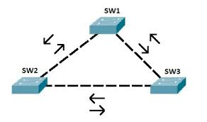
Spanning Tree Protocol (STP)
What is STP?
A Layer 2 protocol used in Ethernet switched networks
Designed to prevent loops when redundant links exist
Automatically creates a loop-free logical topology
Defined in the IEEE 802.1D standard
Essential for networks with multiple interconnections between switches

Slide 29
Redundant Links
Why Redundant Links Create Problems?
Problems Caused by Layer 2 Loops
Broadcast storms: Broadcast frames circulate endlessly
MAC table instability: Switch MAC addresses keep changing, causing incorrect forwarding
Duplicate frames: Same frame arrives multiple times → applications malfunction
Network congestion: Bandwidth becomes saturated
Why Redundancy Is Needed
Provides backup paths
Increases fault tolerance and availability → STP allows redundancy without creating loops

Slide 30
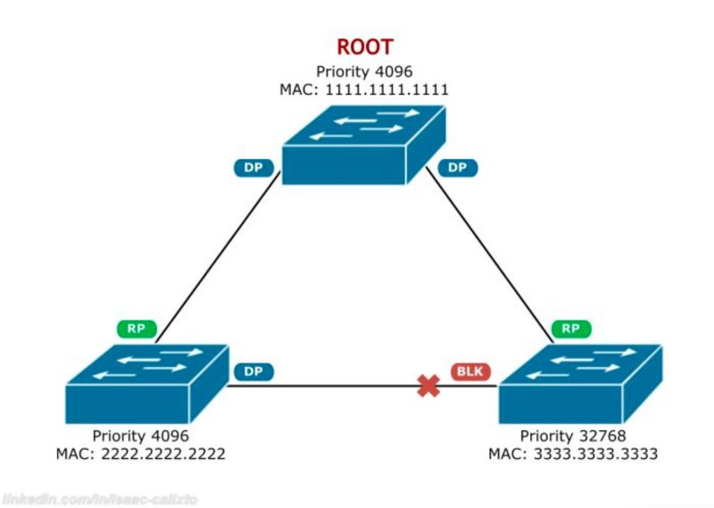
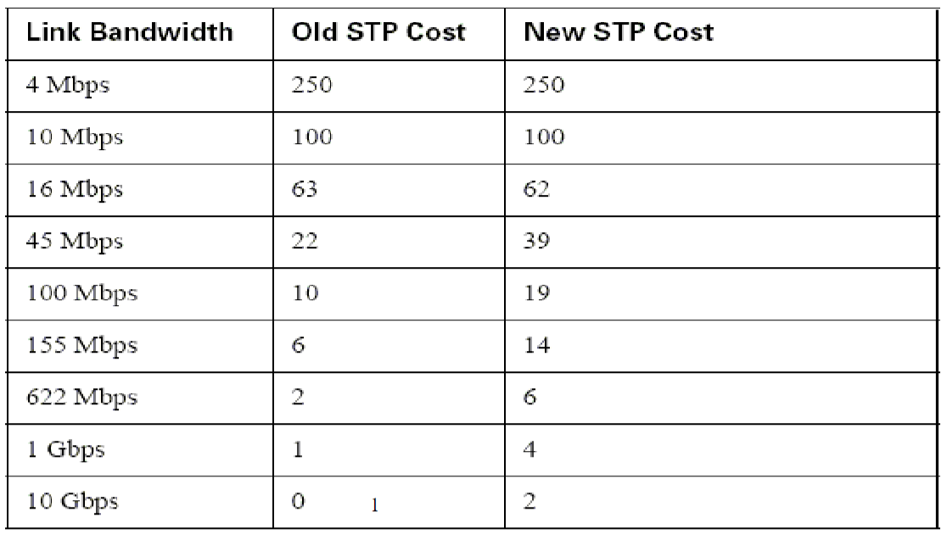
STP Overview
Root Bridge Election: The switch with the lowest BID becomes the Root Bridge, the central point of the network.
Root Port (RP): On each non-root switch, the port with the lowest root path cost (bandwidth/link’s number) to the Root Bridge is selected as the Root Port, which forwards traffic towards the root.
Designated Port: On each segment, the port with the lowest path cost (bandwidth/link’s number) to the Root Bridge is the Designated Port, responsible for forwarding traffic for that segment.
Root Bridge Ports: All ports on the Root Bridge are Designated Ports.
Non-Designated Port (NDP): Any port that isn't a Root Port or a Designated Port.
Blocking State: These ports are placed in a blocking state, preventing them from forwarding user data and thus stopping network loops.

Slide 31
STP Port Roles
1. Root Port (RP)
One per non-root switch
Port with the lowest cost path to the Root Bridge
Always in Forwarding state
2. Designated Port (DP)
One per network segment
Chosen as the best forwarding port on that segment
Also in Forwarding state
3. Non-Designated Port (Blocked Port)
Put in Blocking state
Prevents loops
Does not forward user traffic but listens for BPDUs
Bridge ID

Slide 32
STP Versions
1. STP (802.1D)
Original version
Slow convergence (30–50 sec)
2. RSTP (802.1w)
Faster: 1–3 sec convergence
Simplified states
New port roles
3. MSTP (802.1s)
Groups VLANs into multiple spanning-tree instances
Scalable for large networks
4. Cisco Variants
PVST+: STP per VLAN
Rapid-PVST+: RSTP per VLAN (fast + per-VLAN control)

Slide 33
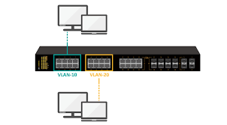
Virtual Local Area Network (VLAN)
A VLAN logically segments a single physical network into multiple isolated broadcast domains, grouping devices by function rather than location for better security, performance, and management.
Works at Layer 2 (Data Link Layer)
Devices in the same VLAN communicate as if they were on the same switch, even if physically separated
Why VLANs?
Better security
Improved network performance
Easier management
Supports network segmentation

Slide 34
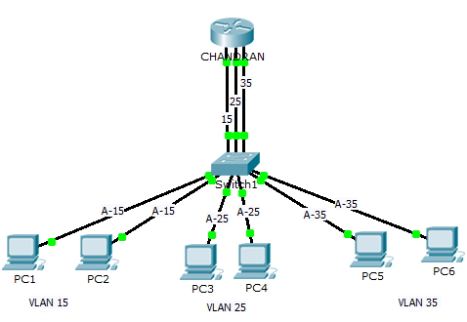
Problems Without VLANs
If all devices are in the same network:
Large broadcast domain
Excessive broadcast traffic
Poor performance
No network segmentation (everyone can see everyone)
Difficult to isolate sensitive devices (servers, VoIP phones, etc.)
VLANs solve these by:
Splitting one switch into multiple mini-networks
Reducing broadcast traffic
Increasing control and security

Slide 35
How VLANs Work VLANs Types
Default VLAN
VLAN 1 on most switches
All ports are members until configured
Data VLAN
Used for user devices
Most common type
Voice VLAN
Dedicated for VoIP traffic
Prioritizes voice packets (QoS)
Management VLAN
Used to access switch management interface
Recommended: NOT VLAN 1
Native VLAN (for trunks)
Carries untagged frames on trunk ports
Key idea:
VLANs separate a switch into multiple logical Layer 2 domains.
Characteristics:
Each VLAN behaves like a separate physical switch
Communication between VLANs requires a router or Layer 3 switch
VLANs are identified by VLAN IDs (1–4094)
Implemented using:
Port-based VLANs (most common)
MAC-based VLANs
Protocol-based VLANs

Slide 36
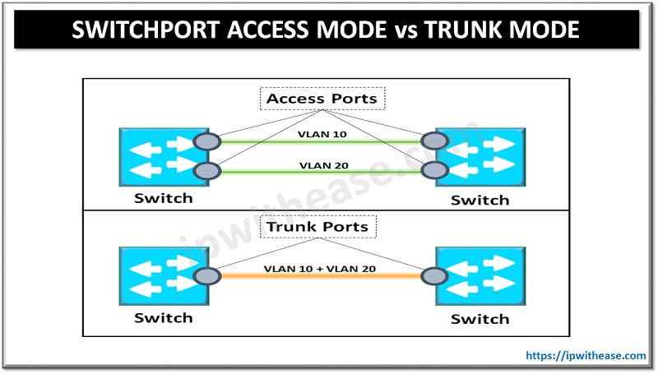
Access Ports vs Trunk Ports
Access Port
Belongs to one VLAN only
Used for end devices (PCs, printers, IP phones)
Sends/receives untagged frames
Trunk Port
Carries multiple VLANs
Used between switches, routers, and servers
Frames are tagged with VLAN ID
Uses the 802.1Q tagging standard

Slide 37
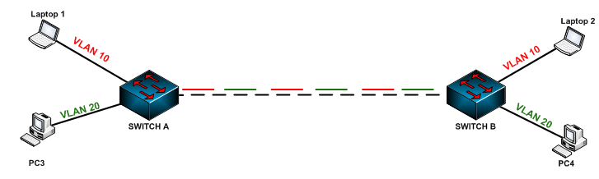
VLAN Trunking Protocole
VLAN trunking is a networking feature that allows multiple Virtual Local Area Networks (VLANs) to traverse a single physical connection. By tagging network traffic with VLAN information, devices such as switches and routers can manage and isolate traffic without needing a dedicated port for each VLAN.
IEEE 802.1Q (Standard)
Industry standard VLAN tagging protocol
Inserts a VLAN tag into Ethernet frames
Supports VLAN IDs 1–4094
Uses a Native VLAN for untagged frames
Supported by all vendors

Slide 38
Objective: Understand the role and importance of network management in modern networks. Explain network management architectures and frameworks. Describe key monitoring protocols and tools. Analyze performance, fault, and configuration management. Apply systematic network troubleshooting methodologies
Chapter 06
Network Management and Monitoring

Slide 39
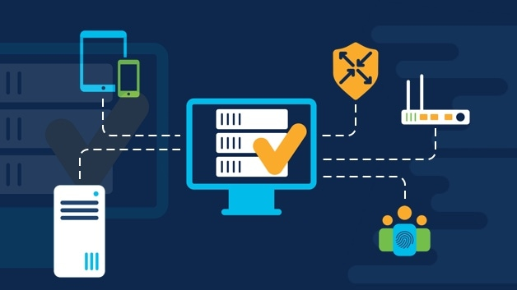
Network Management
Network management refers to the administration, operation, monitoring, and maintenance of computer networks to ensure:
Availability
Performance
Reliability
Security
It enables network administrators to detect problems, optimize performance, and ensure service continuity.

Slide 40
Network Management Domains (FCAPS Model)
The FCAPS model encompasses five distinct management areas, each crucial for effective network management:
Fault Management focuses on the detection, isolation, and resolution of faults or failures within the network. It involves continuous monitoring of network devices and services to identify issues proactively. When faults occur, systems trigger alerts, enabling network administrators to quickly address and rectify problems, thereby minimising downtime and ensuring service reliability.
Configuration Management relates to the oversight of network devices and their configurations. It encompasses the initial setup, ongoing modifications, and documentation of hardware and software configurations.
Accounting Management focuses on tracking resource usage across the network. It involves collecting and analysing data on various metrics such as bandwidth consumption, device utilisation, and service usage. By providing insights into user behaviour and resource allocation, accounting management aids in capacity planning, budgeting, and compliance initiatives, ensuring that resources are used efficiently and effectively.

Slide 41
Network Management Domains (FCAPS Model)
Performance Management, here, the emphasis is on monitoring and optimising the network's quality of service (QoS) and overall efficiency. This includes assessing metrics like latency, throughput, and packet loss to ensure that network performance meets established standards.
Security Management is dedicated to safeguarding network resources against a variety of threats. It encompasses the implementation of security policies, user authentication, intrusion detection, and response strategies. By employing a multi-layered security approach, organisations can protect sensitive data, maintain compliance with regulations, and ensure the overall integrity and confidentiality of the network.
Together, these five management areas form a comprehensive framework essential for the efficient operation and administration of networked systems.

Slide 42
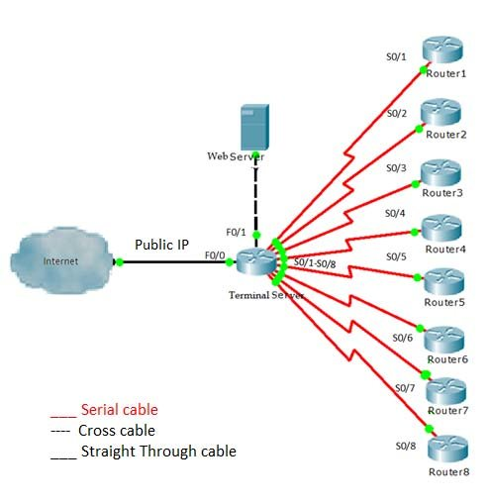
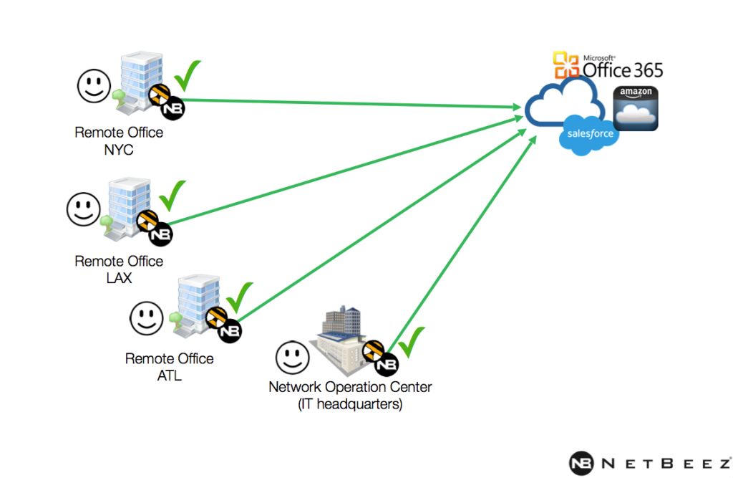
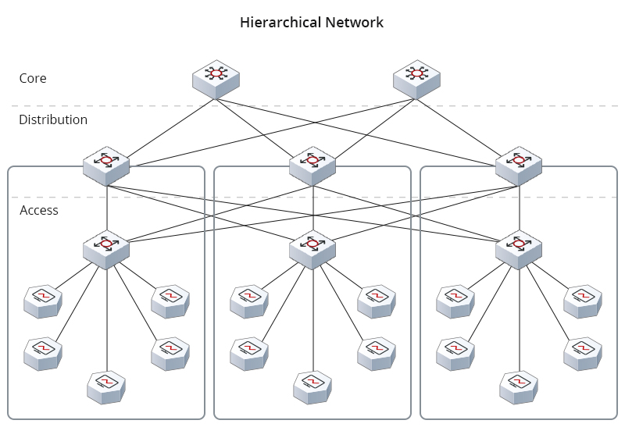
Network Management Architectures
Common architectures include:
Centralized Management: This approach involves consolidating decision-making authority within a single central body or leadership team.
Distributed Management: distributed management empowers individual teams or departments to make decisions relevant to their specific areas.
Hierarchical Management: This system is structured in a tiered format, with multiple levels of authority and clear reporting lines. Hierarchical management facilitates clear role definitions and accountability, making it easier to implement policies and strategies.

Slide 43
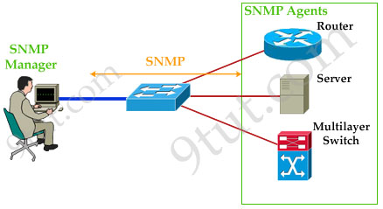
Network Management Protocols and Tools
Simple Network Management Protocol (SNMP)
SNMP is the most widely used network management protocol.
Key components:
Manager – management station
Agent – runs on network devices
MIB – management information base

Slide 44
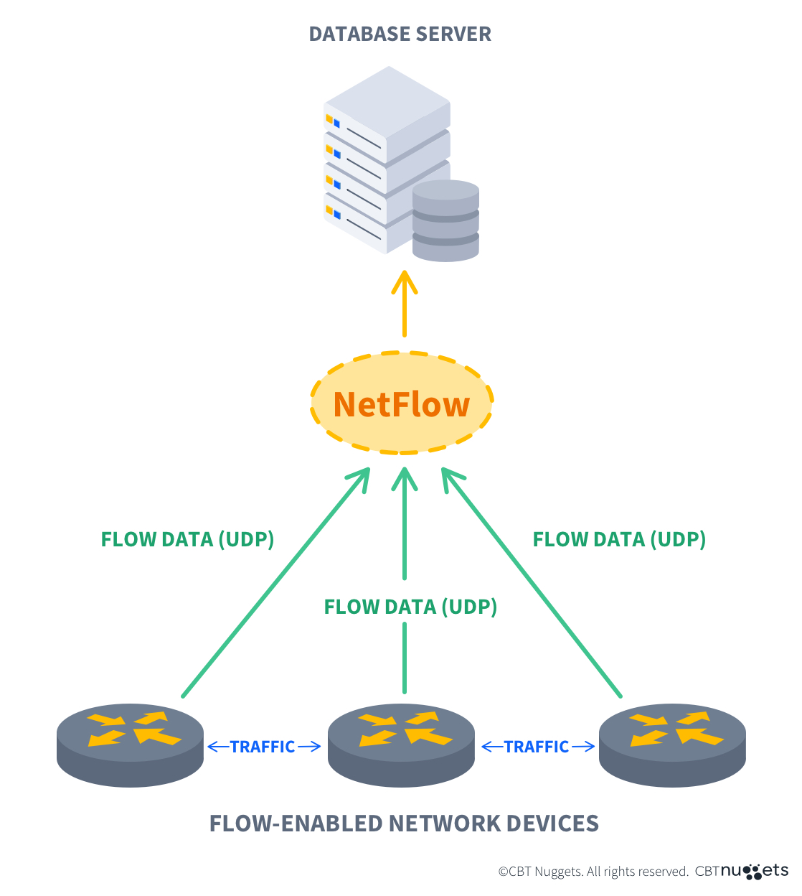
NetFlow and Traffic Monitoring
Originally a Cisco technology, is an industry-standard protocol for collecting IP traffic metadata (like source/destination IP, ports, protocols, bytes) from network devices (routers, switches) to provide deep visibility into network usage, performance, security, and accounting, helping administrators understand traffic patterns, troubleshoot issues, detect threats like DDoS, and optimize bandwidth by sending flow data to a central collector for analysis.
NetFlow collects traffic flow statistics, including:
Source and destination IP
Ports
Protocols
Volume and duration
Used for:
Traffic analysis
Capacity planning
Anomaly detection

Slide 45

Network Troubleshooting
Network troubleshooting is the systematic process of identifying, diagnosing, and resolving problems that affect network connectivity, performance, or reliability.
Why Network Troubleshooting Is Challenging
Network problems are difficult because:
Networks are distributed systems
Problems may occur at multiple layers
Symptoms and causes are often different
Changes in one part affect others
Effective troubleshooting requires:
Methodology
Layered thinking
Accurate observation

Slide 46
Structured Troubleshooting Methodology
Typical issues include:
No connectivity
Intermittent connectivity
High latency or jitter
Packet loss
Routing loops or black holes
Misconfigurations
Security-related disruptions
Two common approaches:
Bottom-Up
Start at Physical Layer
Check cables, interfaces, signals
Move upward
Top-Down
Start at Application Layer
Check services and protocols
Move downward
Choice depends on:
Symptoms
Network complexity
Time constraints
A recommended step-by-step method:
Identify the problem
Define the scope
Gather information
Analyze possible causes
Test hypotheses
Apply the solution
Verify and document
This avoids random trial-and-error.

Slide 47
Objective: Understand the core principles and technologies of wireless communication. Explain mobile network architectures and protocols. Analyze security, QoS, and mobility management in wireless and mobile networks. Identify the challenges and design considerations of modern wireless and mobile systems.
Chapter 07
Wireless and Mobile Networks

Slide 48
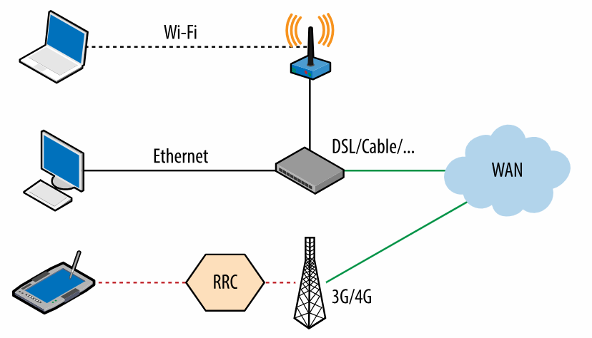
What Are Wireless and Mobile Networks?
Wireless networks transmit data without physical cables, using radio waves. Mobile networks extend wireless networks by supporting user movement while maintaining connectivity.
Examples:
Wi-Fi networks
Cellular networks (4G/5G)
IoT and sensor networks
Vehicular networks
Wireless communication involves:
Encoding data into electrical signals
Modulating signals onto radio waves
Transmitting through free space
Demodulating and decoding at the receiver
Unlike wired media, the wireless medium is shared, open, and unpredictable.

Slide 49
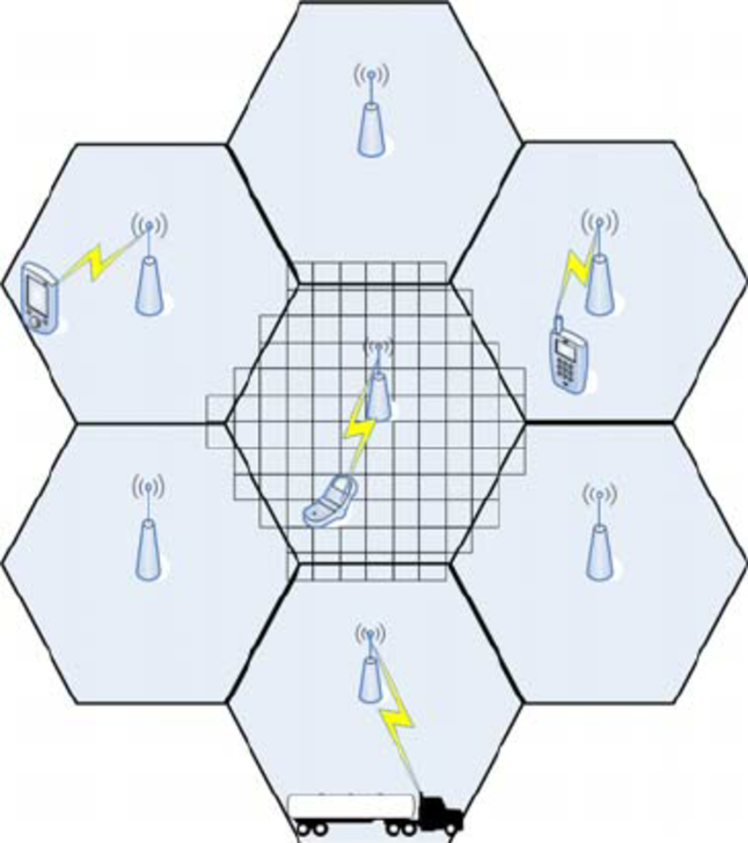
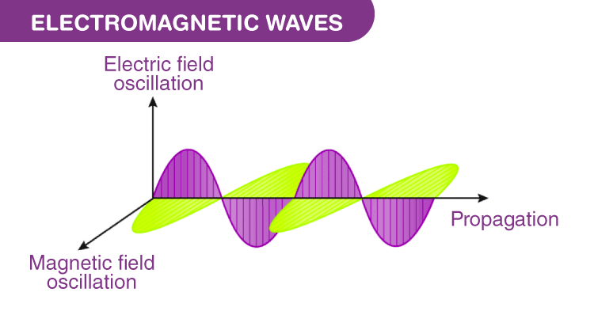
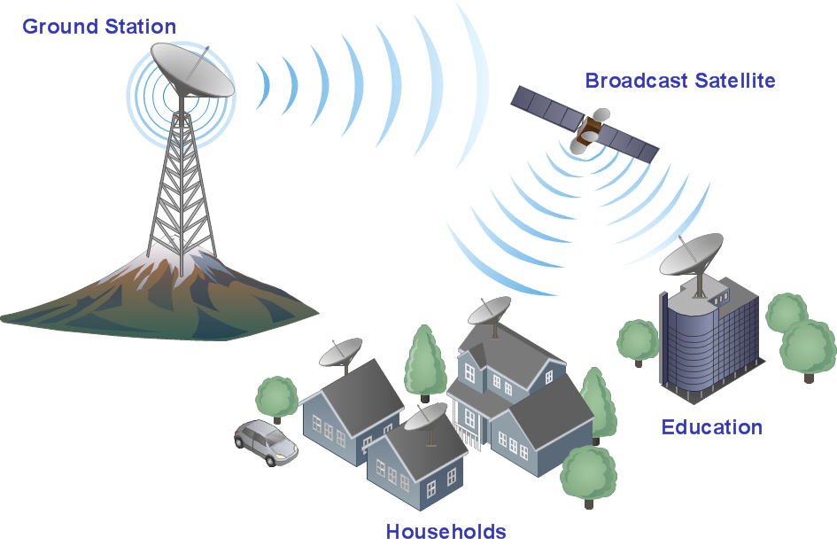
Foundations of Wireless Communication
Electromagnetic Waves: Information travels as radio waves, characterized by frequency and wavelength, requiring antennas for transmission and reception.
Wireless Medium: Inherently shared and subject to interference, requiring techniques to manage multiple users.
Cellular Concept: Developed in the 1960s/70s, enabling large-scale mobile networks.

Slide 50
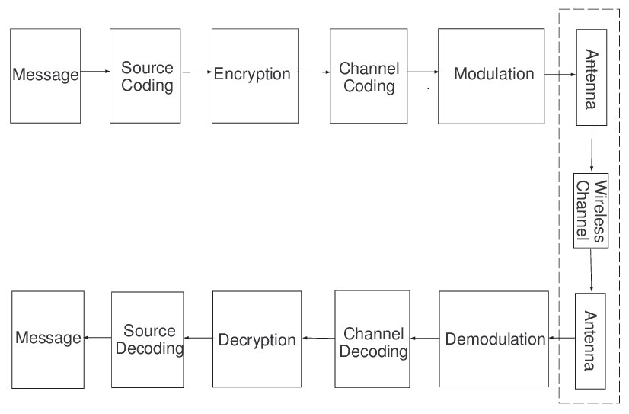
Wireless Communication Link

Slide 51
Wireless Communication Link Blocks
Information Source This block generates the original data to be transmitted, such as voice, video, text, or sensor measurements. The data can be analog or digital depending on the application.
Source Encoder The source encoder compresses the data to reduce the required transmission bandwidth. It removes redundancy while maintaining acceptable quality (e.g., audio or video compression).
Channel Encoder This block adds controlled redundancy to the data to enable error detection and correction at the receiver. It improves transmission reliability over noisy wireless channels.
Modulator The modulator maps digital bits into symbols and modulates them onto a carrier signal. This makes the signal suitable for efficient wireless transmission (e.g., PSK, QAM).
Transmitter (RF Front-End)
The transmitter amplifies the modulated signal and shifts it to the desired radio frequency. It then sends the signal through the transmitting antenna.

Slide 52
Wireless Channel The wireless channel represents the air medium through which the signal propagates. It introduces impairments such as noise, fading, interference, and path loss.
Receiver (RF Front-End) The receiver captures the signal using an antenna and performs filtering, amplification, and downconversion. Its goal is to prepare the signal for accurate detection.
Demodulator This block extracts the transmitted symbols or bits from the received signal. It compensates for channel effects as much as possible.
Channel Decoder The channel decoder detects and corrects errors introduced during transmission. It uses the redundancy added by the channel encoder to improve data integrity.
Source Decoder The source decoder reconstructs the original data from the compressed format. It aims to restore the signal with minimal distortion.
Destination The destination is the final user or application that consumes the received information. This can be a human user or a machine system.

Slide 53
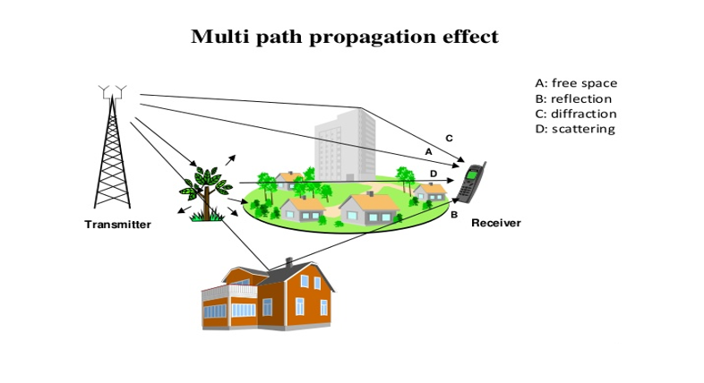
Wireless Signal Propagation Effects
Key propagation issues:
Path loss: signal weakens with distance
Shadowing: obstacles block signal
Multipath fading: reflections cause interference
Noise and interference: degrade signal quality
These effects cause fluctuating bandwidth and packet loss.

Slide 54
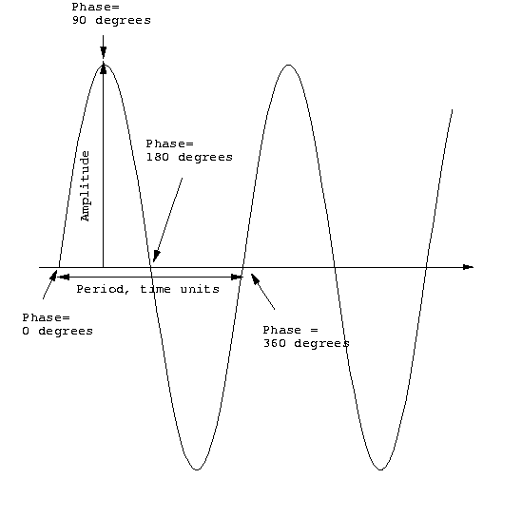
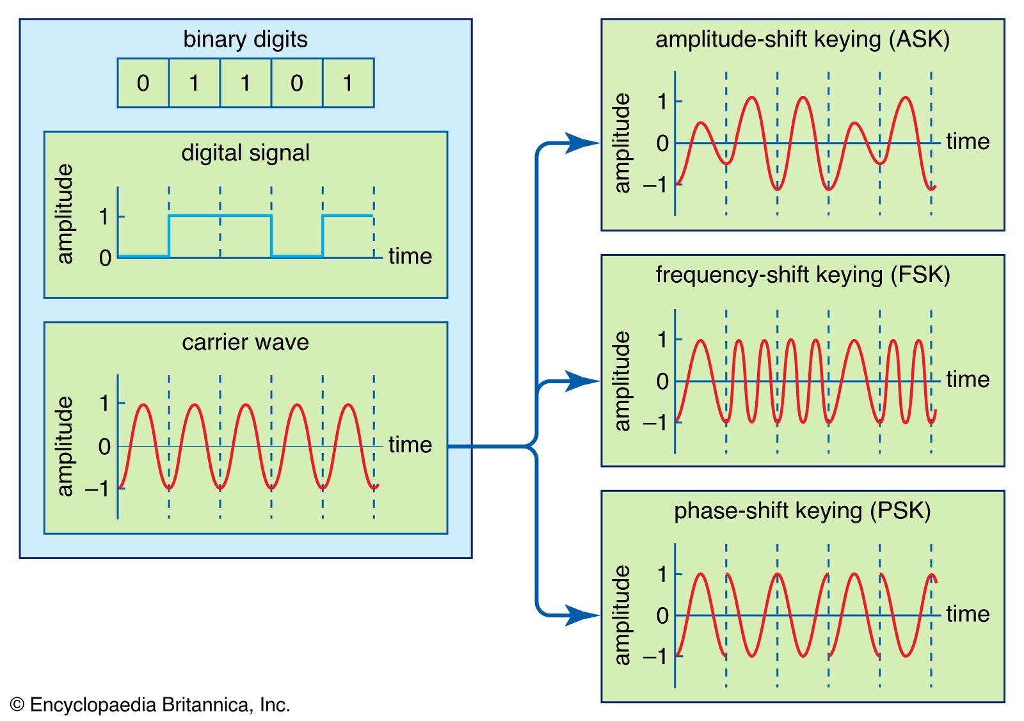
Modulation Techniques
Modulation converts digital data into radio signals,

Slide 55
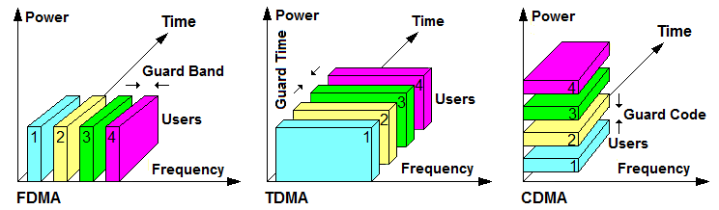
Multiple Access Techniques
Because the wireless medium is shared:
FDMA – divide frequency
TDMA – divide time
CDMA – divide by code

Slide 56
Wireless Technologies Overview
Technology | Range | Data Rate | Typical Use
Wi-Fi | Medium | High | Local networks
Cellular | Large | Medium–High | Mobile access
Bluetooth | Short | Low | Peripheral devices
Zigbee | Short | Very Low | IoT sensors
LPWAN | Very Large | Very Low | IoT monitoring

Slide 57
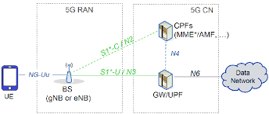
Mobile Network Architecture
MNA is the structured framework of components that enables wireless communication, managing radio signals, user mobility, data routing, and service provision, evolving from circuit-switched systems (2G/3G) to packet-switched IP-based networks (4G/5G) for seamless data, voice, and application support, using concepts like Network Function Virtualization (NFV) for flexibility.
Key Components
User Equipment (UE): Your mobile device (phone, tablet).
Radio Access Network (RAN): The antennas and base stations (BTS/eNB) that connect UEs to the network via radio waves, managing spectrum efficiently.
Core Network (CN): The central brain, managing sessions, authentication, mobility, and routing data between the RAN and external networks.
Data Network/Backhaul: Connects the core network to the internet and other data services.

Slide 58
Security in Wireless and Mobile Networks
Wireless and mobile networks face greater security risks than wired networks because the transmission medium is open and shared.
Wireless Security Challenges
Radio signals can be intercepted by anyone within range
Devices frequently join and leave the network
Mobility introduces handover vulnerabilities
Heterogeneous technologies increase attack surfaces
Common Wireless Attacks
Eavesdropping: attackers capture unencrypted traffic
Spoofing: fake access points or fake identities
Man-in-the-Middle (MITM): attacker intercepts and alters communication
Jamming: intentional interference to block communication
Rogue Access Points: unauthorized APs mimicking legitimate ones

Slide 59
Security Mechanisms and Protections
Authentication Ensures only legitimate users access the network (SIM-based auth in cellular, EAP in Wi-Fi)
Encryption Protects confidentiality of data (WPA3 in Wi-Fi, AES-based encryption in LTE/5G)
Integrity Protection Ensures data is not modified during transmission
Access Control Controls which devices and services are allowed

